Slide 1

PROGRAMMING WITH PYTHON
Data Pre Processing

Slide 2
Agenda
Data analysis in Python
Univariate, bivariate and multivariate analysis
Data normalization and scaling
One hot encoding
Missing values imputation
Working with outliers
Summary

Slide 3
Data Analysis In Python
Visualization - Fastest way of analyzing data
Helps in understanding distribution of variables in the data
Correlation – helps in analyzing correlation between each variable in the dataset
Python visualization libraries – Matplotlib, Seaborn, Plotly
Variables category : Univariate, Bivariate, Multivariate
Variable analysis
Univariate
Bivariate
Multivariate

Slide 4
Univariate Analysis
Displot
Simplest form of analyzing data
Helps to understand visible and descriptive details of a “single” variable involved
Mainly describes pattern in data
Histogram
Summary plots
Boxplot
Violin plot
Univariate plots
Scatter plot
Line plot
Enumerative plots
Strip plot
Swarm plot

Slide 5
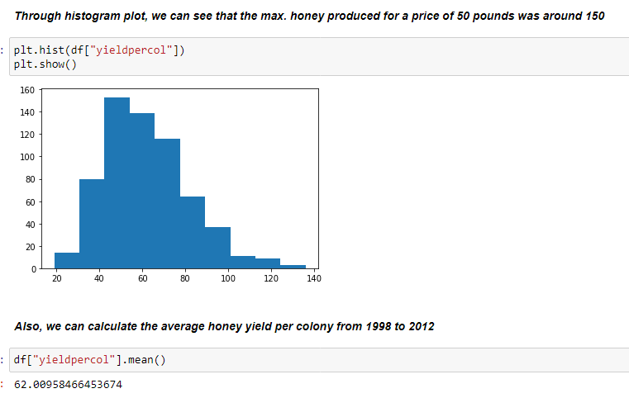
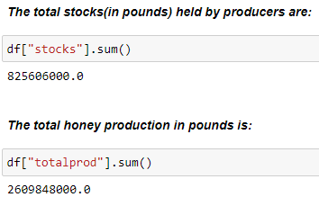
Univariate Example

Slide 6
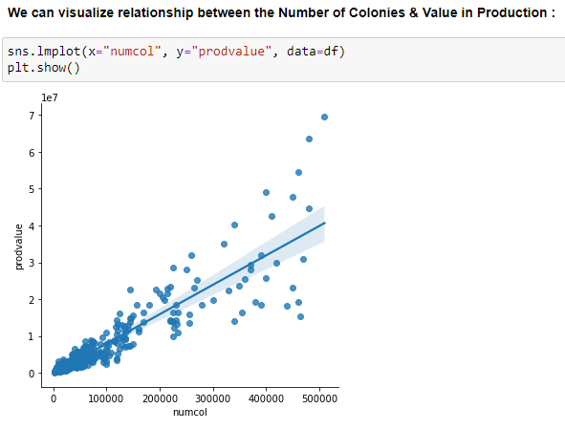
Bivariate Analysis
Helps to understand relationship between two variables
Visualization/Tabular based methods:
Scatter plot - analysis of two numerical variables
Crosstab - analysis of two categorical variables
Boxplot - analysis of a numerical variable and a categorical variable
Statistical tests:
Z-test and t-test – analysis of numerical and categorical variables
Chi – square test - analysis of two categorical variables

Slide 7
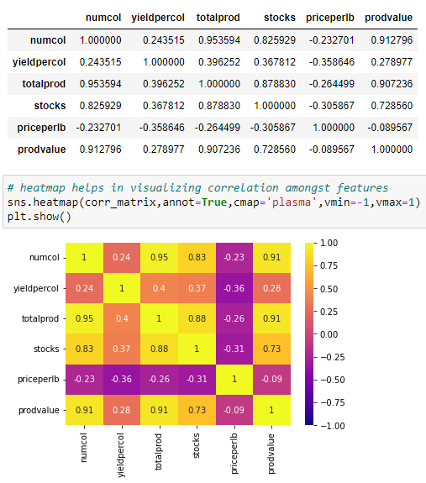
Correlation
To find if variables are related in any way
Pandas corr() method - generates correlation matrix
Seaborn heatmap() - helps to visualize correlation

Slide 8
Multivariate Analysis
More than two variables analysis
Helps to understand complex data
Conclusion drawn are more realistic
Visualization methods:
Pairplots
Plotly plots
Various techniques – MANOVA (Multivariate analysis of variance), Multiple linear regression, Factor analysis, Cluster analysis, etc.
Multivariate techniques
Dependence
Interdependence
One or more variables shows dependency among each other.
No dependency amongst variables – try to group variables in a meaningful way.

Slide 9
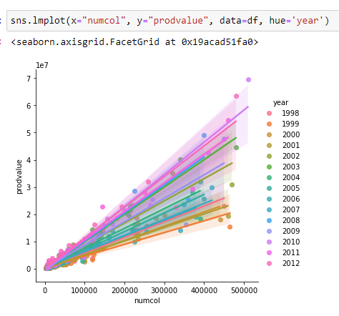
Multivariate Example

Slide 10
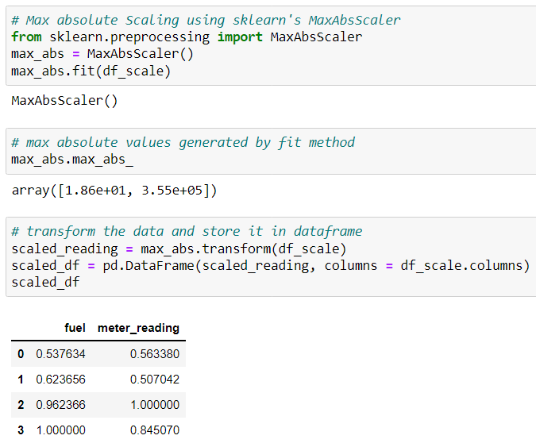
Data Normalization And Scaling
Data normalization – Transforms different scaled data to common scale
Min max scaling (fixed range 0 to 1)
Standard scaling also called - z– score (ranges from -3 to 3)
Max absolute scaling (ranges between -1 to 1)

Slide 11
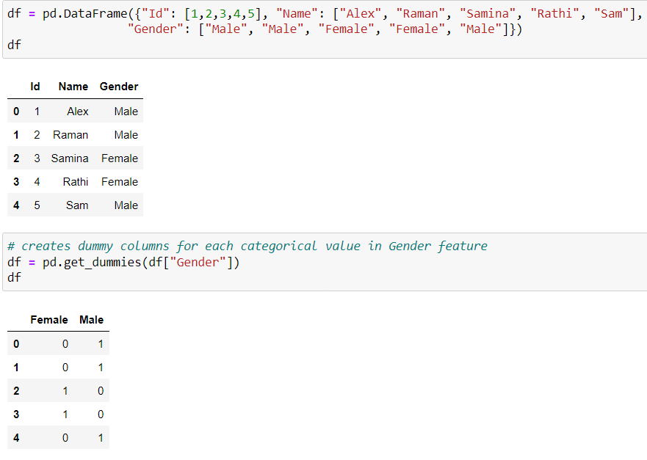
Data Preprocessing - One Hot Encoding
Almost all machine learning algorithms needs categorical conversion
Categorical to integer number mapping
Each categorical value is mapped to new columns with binary values 0 or 1
Useful for data which has no relations
Pandas get_dummies() method
Other methods:-
Manual encoding
Label encoding

Slide 12
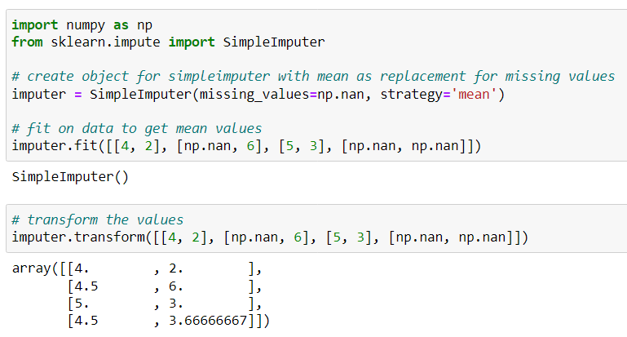
Missing Values Imputation
For unknown reasons data contain missing values
Blank space, nan values
With price of losing data, one can discard missing value rows and/or columns
Better approach is to impute missing values with mean, median, mode or a constant

Slide 13
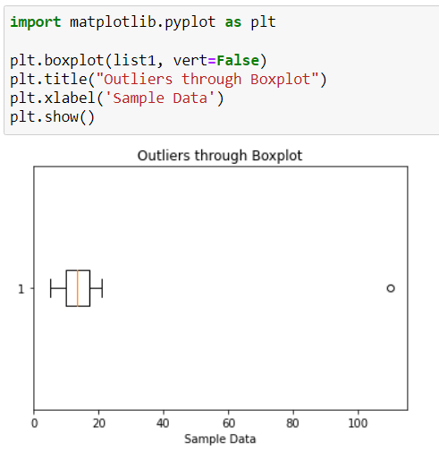
Dealing With Outliers
“Odd one Out”
Mean – only measure which is affected which in turns affect Standard deviation
Negatively affects training data of a machine learning model
Can be identified through – Box plot, z-score, Interquartile range (IQR)
Can be removed or imputed

Slide 14
Summary
Discussed univariate, bivariate and multivariate analysis.
Normalization and scaling in Python.
Data preprocessing such as one hot encoding, missing value imputation, dealing with outliers.

Slide 15
Hands On

Slide 16
THANK YOU Happy Learning ☺

